Slide 1
PROJ324
Progress
Demonstration
https://www.google.co.uk/search?as_st=y&tbm=isch&hl=en&as_q=circuit&as_epq=&as_oq=&as_eq=&cr=&as_sitesearch=&safe=images&tbs=sur:f#imgrc=WSh_rfezQCWQEM:
Zbigniew Druzbacki
10525366

Slide 2
Overall Progress
Gantt Chart Milestone Overview:
Milestone | Milestone Deadline | Progress
Establish a Communication Network Between All Components | 07/01/2019 | 79%
Perform Tests On The IMU | 28/02/2019 | 68%
Perform Tests On the Hall-Effect Sensor | 28/02/2019 | 0%
Design and Build of Attachment Frame For the Human Arm | 14/03/2019 | 0%
Design and Build of Robotic Arm | 03/05/2019 | 8%

Slide 3
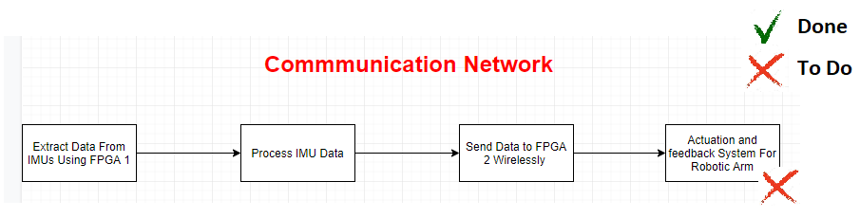
Communication
Network

Slide 4
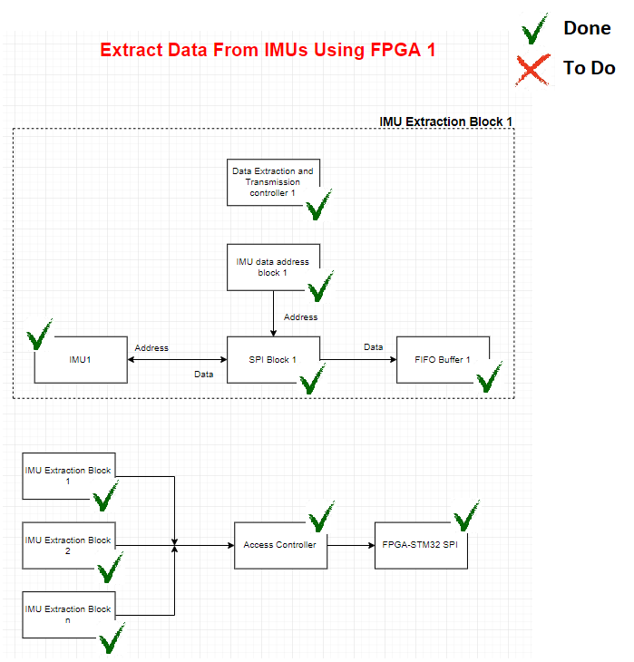
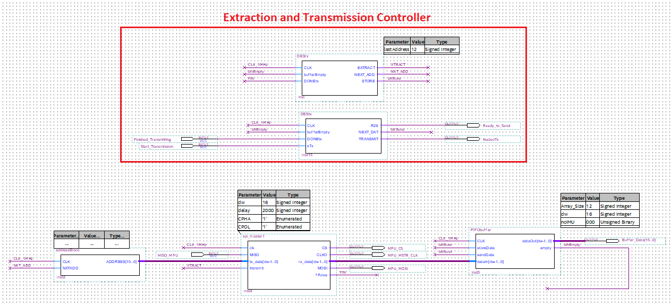
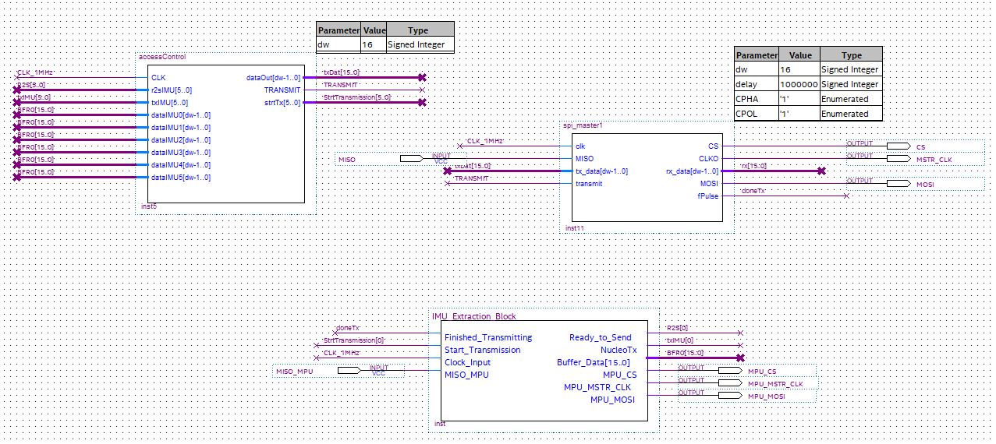
Communication Network:
IMU Data Extraction
Add video links from youtube

Slide 5
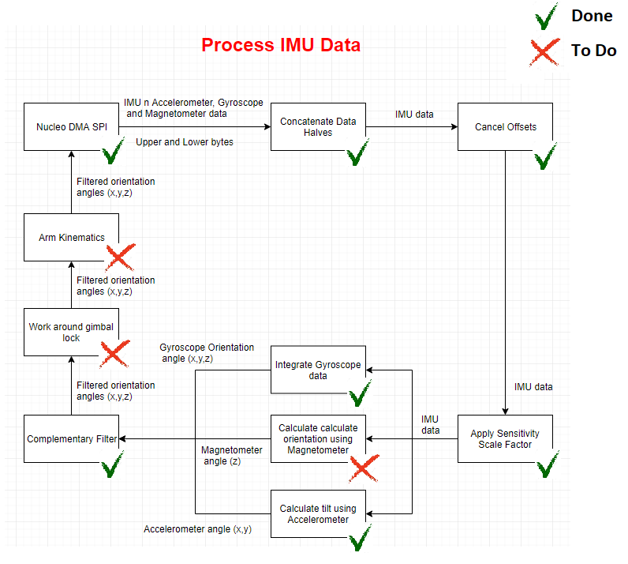
Communication Network:
Processing IMU data

Slide 6
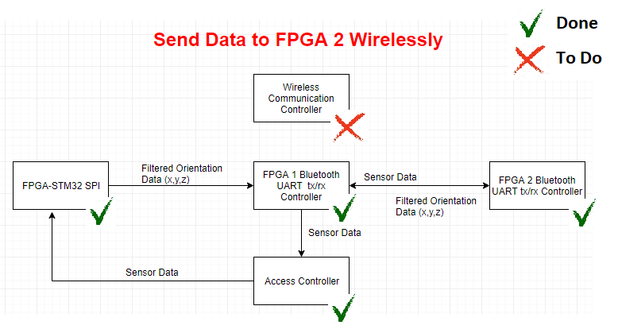
Communication Network:
Sending Data Wirelessly

Slide 7
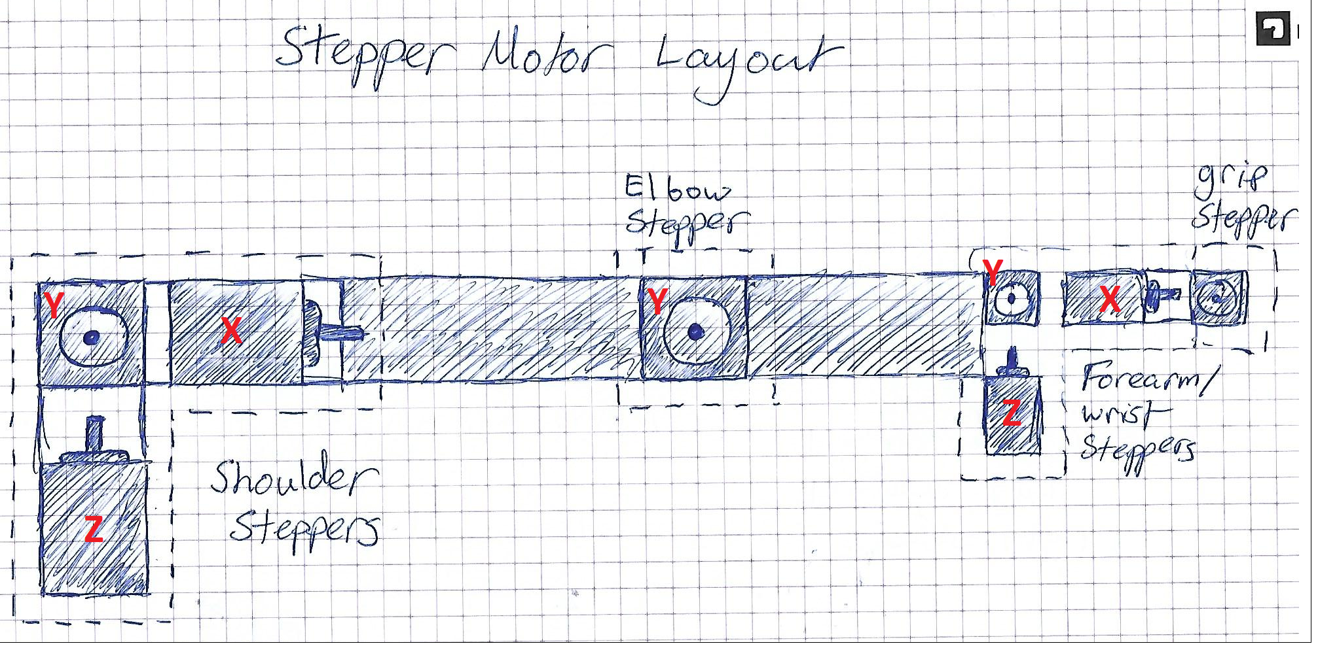
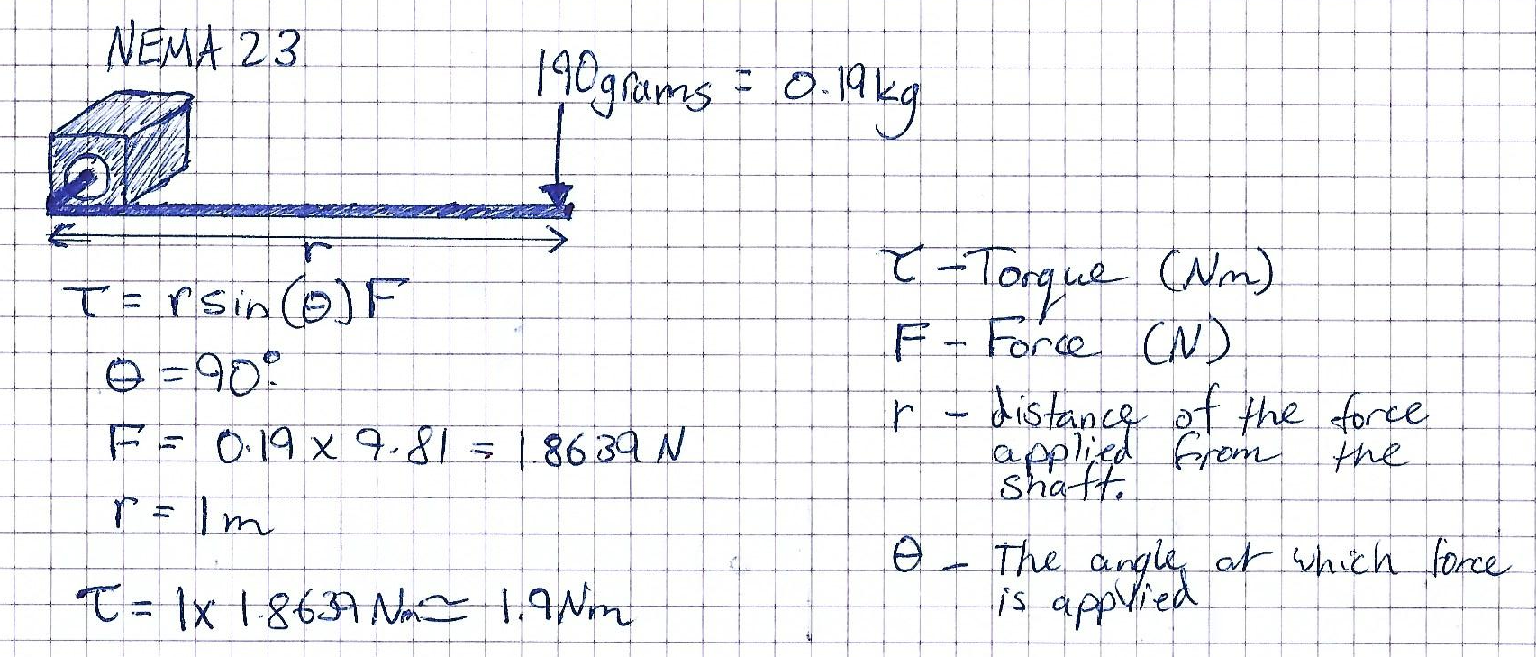
Robotic Arm

Slide 8
Changes

